Slide 1
JavaScript DOM(Document Object Model)

Slide 2

JavaScript HTML DOM Tree (Model)
Note : With the HTML DOM, JavaScript can access and change all the elements of a HTML document

Slide 3
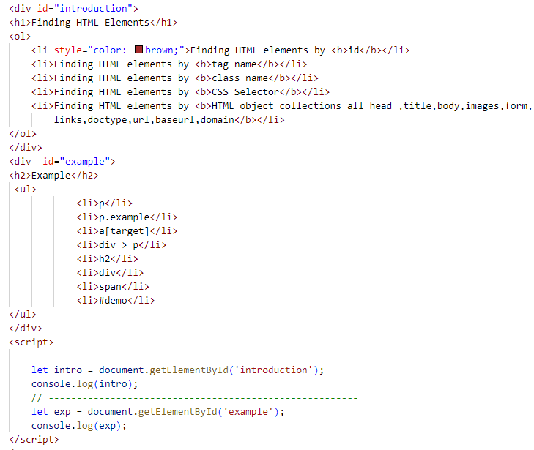
Finding HTML elements by ID
Get the element with the specified id:

Slide 4

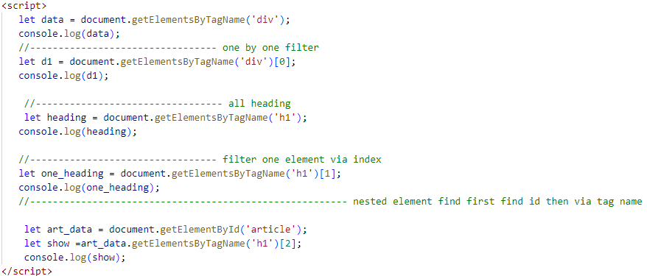
Finding HTML elements by TAG Name
The getElementsByTagName() method returns a collection of all elements with a specified tag name.

Slide 5
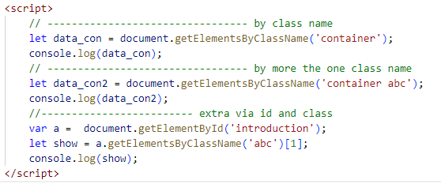
Finding HTML elements by CLASS
The getElementsByClassName() method returns a collection of elements with a specified class name(s).

Slide 6
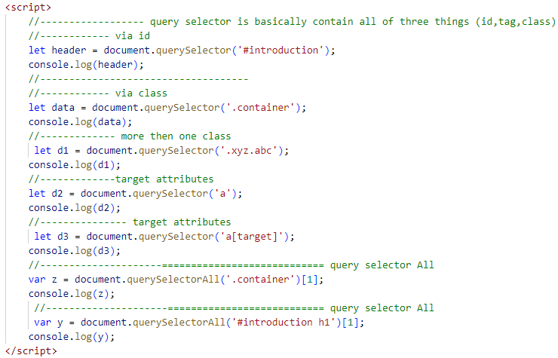
Finding HTML elements by CSS Selector
The querySelector() method returns the first element that matches a CSS selector.
To return all matches (not only the first), use the querySelectorAll() instead.

Slide 7
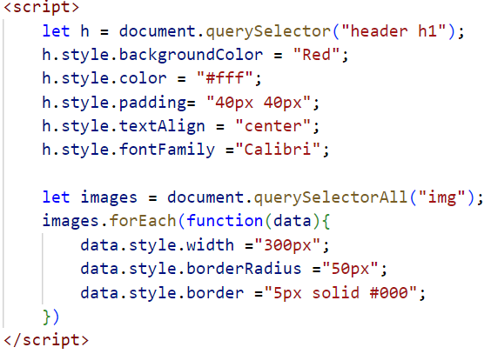
Style dom property

Slide 8
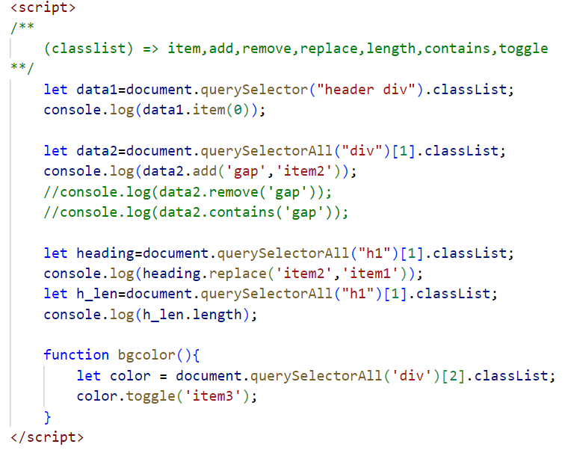
classList

Slide 9
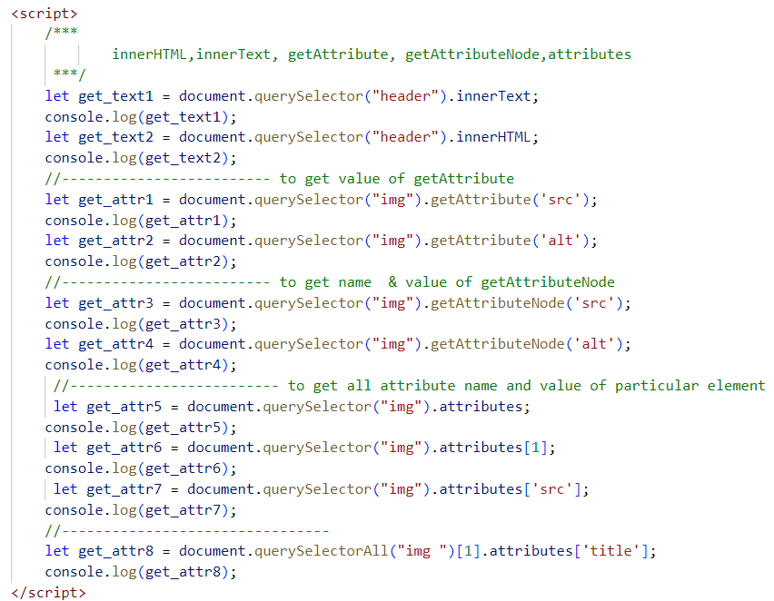
Get DOM Value

Slide 10
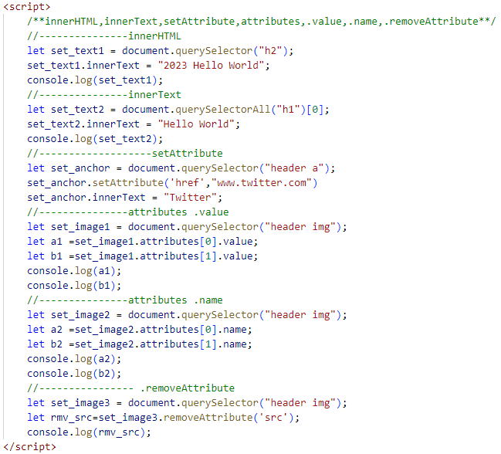
SET DOM Value

Slide 11
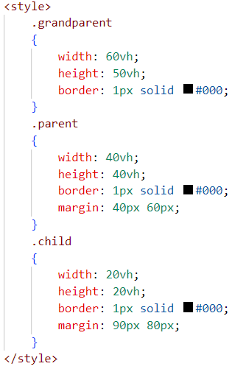
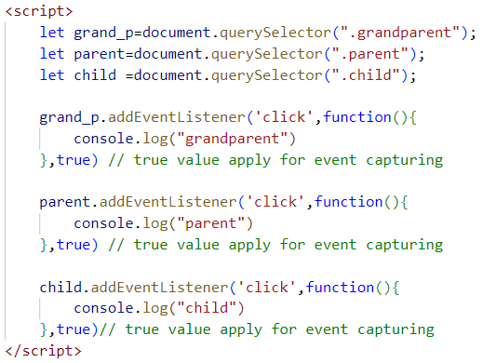
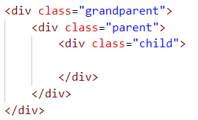
event bubbling and event capturing

Slide 12

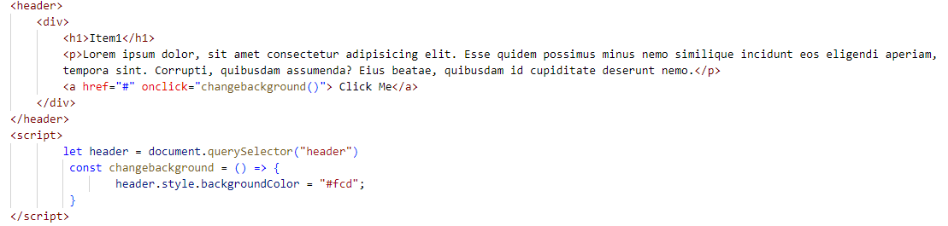

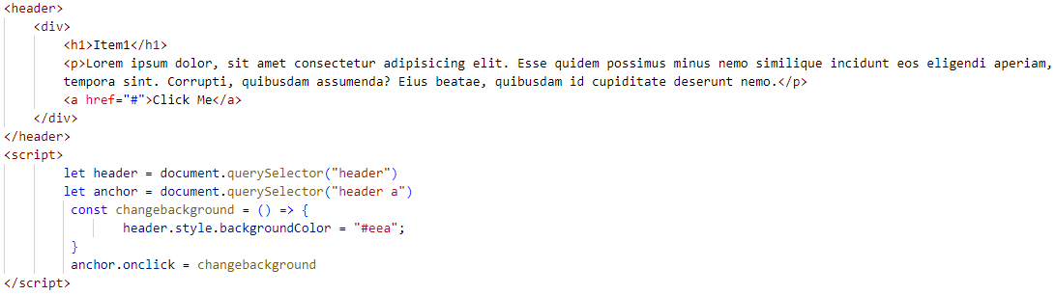
addEventListener
Event use

Slide 13

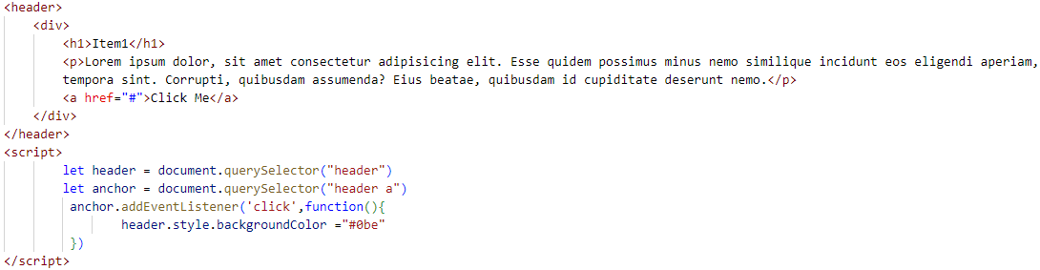

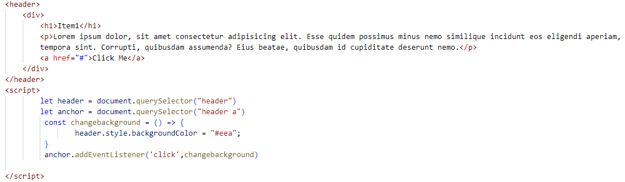
addEventListener

Slide 14
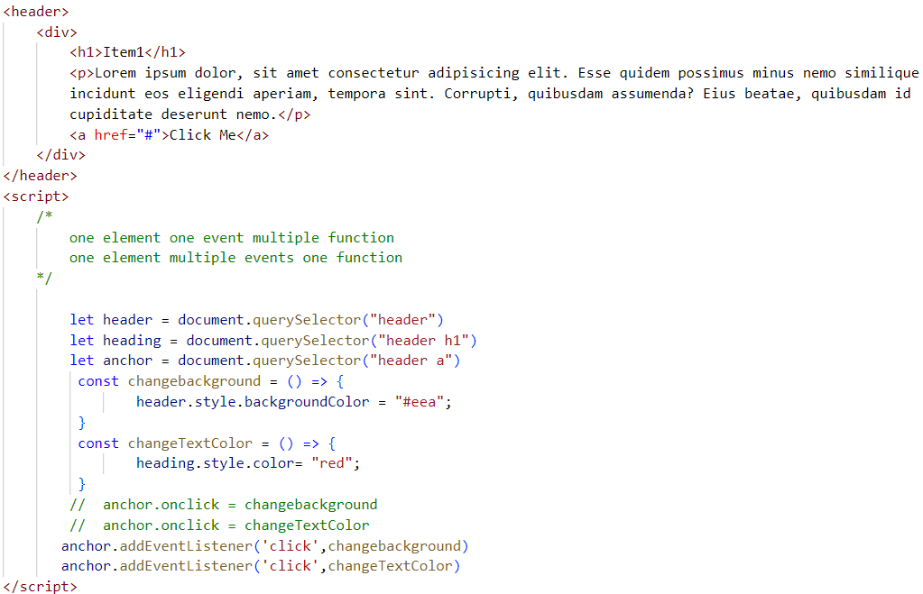
addEventListener

Slide 15
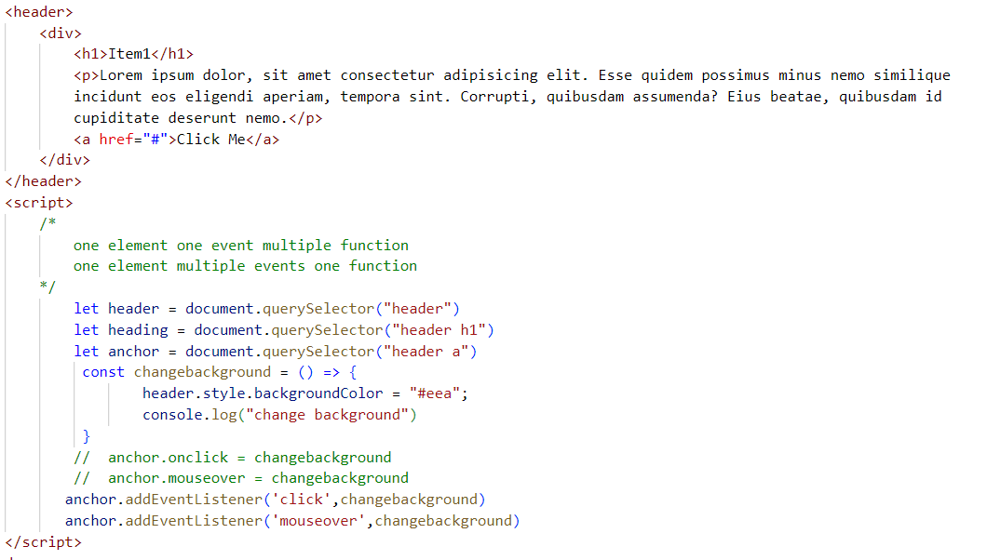
addEventListener

Slide 16

Exercise - testimonial
In promotion and advertising, a testimonial or show consists of a person's written or spoken statement extolling the quality of a product.

Slide 17
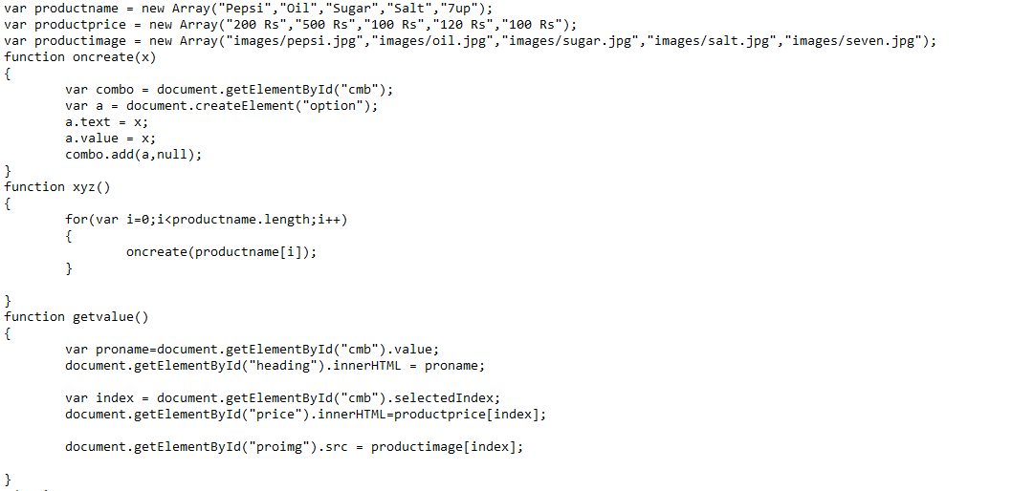
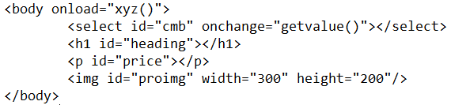
Exercise – Dropdown Selection

Slide 18
